Slide 1
Introduction to Web Development

Slide 2
What is Web Development?
Introduction to Web Development
Web development is the process of creating websites and web applications. It involves a combination of programming languages, design principles, and technical skills to build and maintain websites that are functional and user-friendly.
Key Technologies and Languages
Essential languages and technologies include HTML, CSS, and JavaScript. HTML provides the building blocks of a website's structure, while CSS is used for styling and layout. JavaScript adds interactivity to websites and is essential for creating dynamic web applications.
Back-end languages like Python, Ruby, and PHP are also important for web development. These languages are used to build the server-side of web applications, which handle data processing, storage, and retrieval.

Slide 3
Frontend Vs Backend?

Slide 4
Frontend vs Backend
Frontend
The frontend of a website is the part that users interact with directly. It includes the visual design, layout, and user interface elements such as buttons, forms, and menus. Frontend development typically involves HTML, CSS, and JavaScript.
Backend
The backend of a website is the part that users do not see, but that enables the frontend to function properly. It includes the server, database, and application logic that work together to process and store data, and to respond to user requests. Backend development typically involves programming languages such as PHP, Python, or Ruby..

Slide 5

HTML: The Building Blocks of the Web
HTML, or Hypertext Markup Language, is the foundation of every website. It provides the structure and content of web pages, including text, images, and other media. HTML uses a system of tags and attributes to define the different elements of a web page, such as headings, paragraphs, and links.
Learning HTML is essential for anyone interested in web development, as it provides the basic building blocks for creating web pages and applications. Whether you are creating a simple blog or a complex e-commerce site, HTML is the starting point for all web development projects.

Slide 6
CSS: Styling and Layout. Cascading Style Sheets, or CSS, is a style sheet language used for describing the presentation of a document written in HTML or XML. CSS is used to style and layout web pages, and it allows developers to separate the content of a web page from its presentation. This makes it easier to make changes to the design of a website without having to modify the content. CSS can be used to control the layout of a web page, including the placement of elements, the size of elements, and the spacing between elements. It can also be used to style text, backgrounds, borders, and other visual elements of a web page.
CSS Syntax
CSS uses a simple syntax that consists of a selector and a set of declarations. The selector is used to target the element or elements that you want to style, and the declarations are used to specify the styles that you want to apply. Here is an example of a simple CSS rule:
h1 { color: red; }
In this example, the selector is "h1", which targets all the <h1> elements on the page. The declaration is "color: red", which sets the text color of the <h1> elements to red.

Slide 7
JavaScript: Adding Interactivity
JavaScript is a programming language that allows you to add interactive elements to your website, such as dynamic forms and animations.

Slide 8
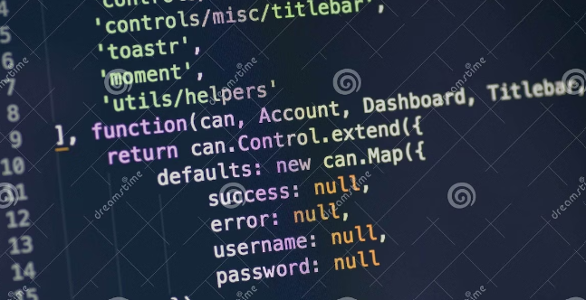
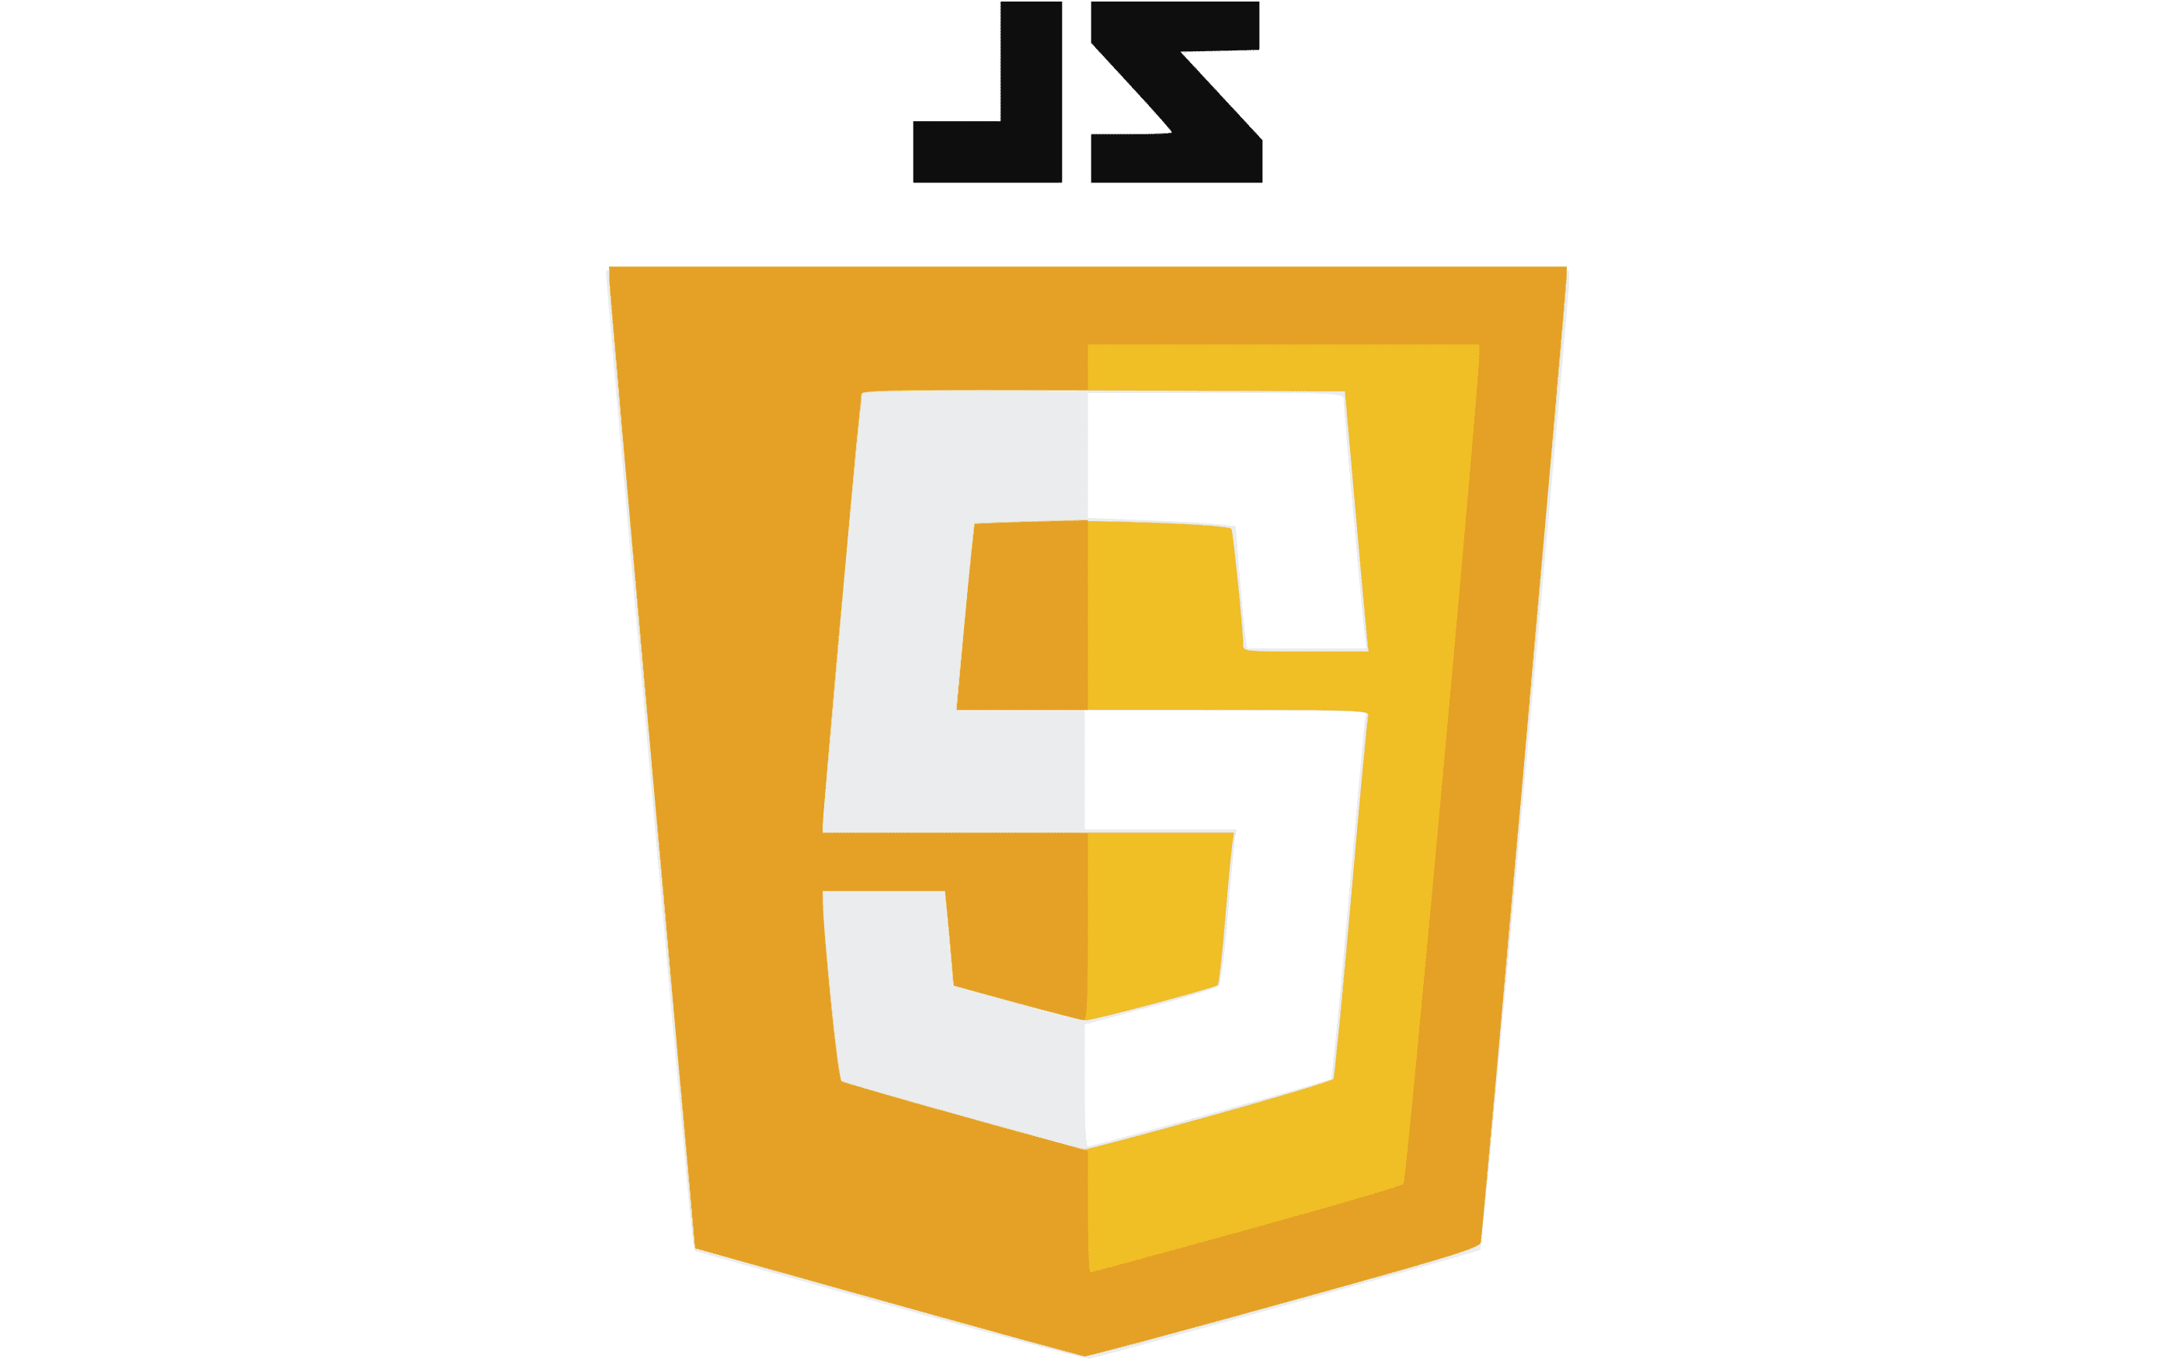
Introduction to JavaScript JavaScript is a programming language that is widely used for creating interactive web pages and web applications. It was created by Brendan Eich in just 10 days in 1995, and has since become one of the most popular programming languages in the world.

Slide 9
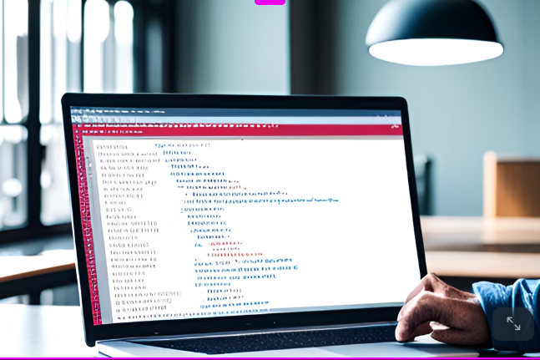
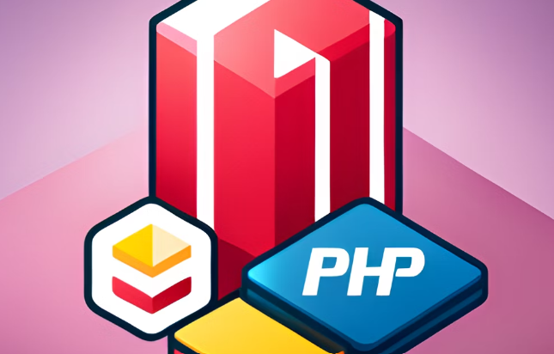
Back-End Languages: Python, Ruby, PHP

Slide 10
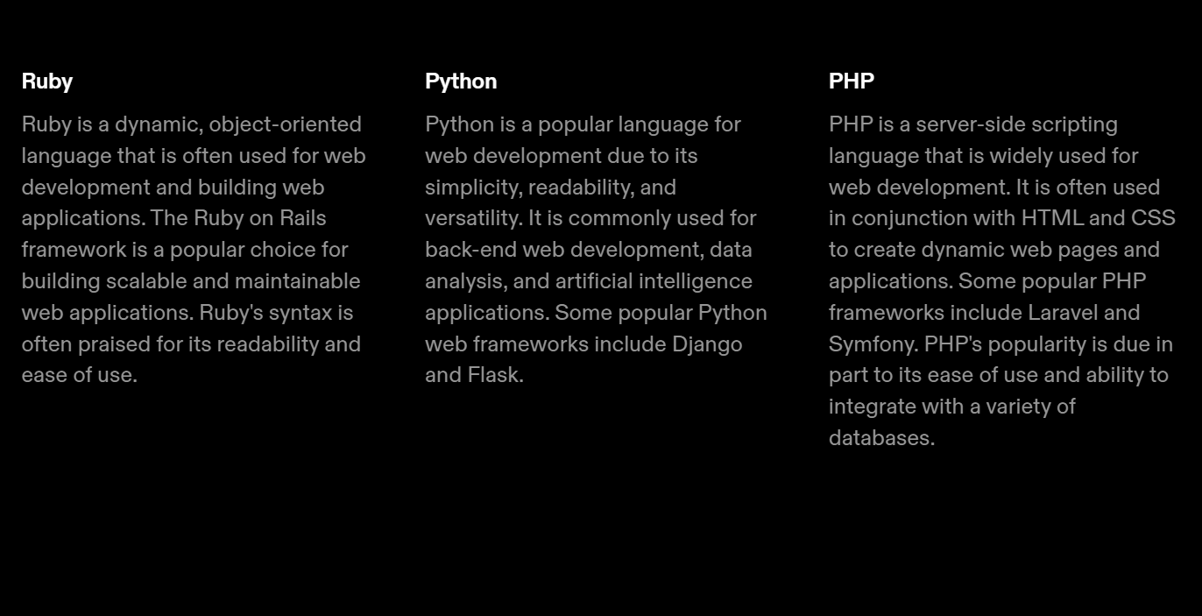

Slide 11
Web Development Tools and IDEs

Slide 12
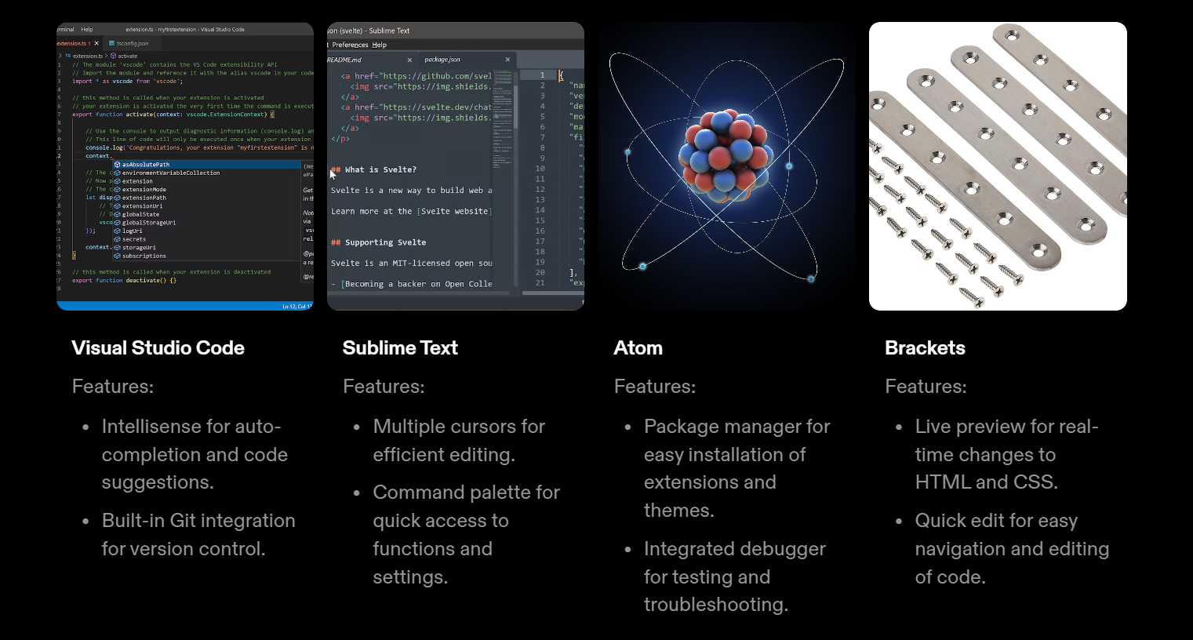

Slide 13
Thank You

